Slide 1
What does secure mean?
What does secure imply?
Notes:
Confidentiality: authorized access, Integrity : accurate unmodified consistent, Availability: get when needed. Security implies trust.

Slide 2
Vulnerabilities, Threats & Controls
What is a vulnerability?
What is a threat?
What is a control?
Notes:
Vulnerability = weakness Threat = potential negative harmful occurrence, Control = protective measure

Slide 3
Vulnerabilities, Threats & Controls
Vulnerability = a weakness in a system
Allows a threat to cause harm
Threat = a potential negative harmful occurrence
Earthquake, worm, virus, hackers.
Control/Safeguard = a protective measure
Reduce risk to protect an asset.

Slide 4
What is CIA ?

Slide 5
CIA Triad
Information kept must be available only to authorized individuals
Unauthorized changes must be prevented
Confidentiality
Integrity
Information
Security
Availability
Authorized users must have access to their information for legitimate purposes
Note: From “Information Security Illuminated”(p.3), by Solomon and Chapple, 2005, Sudbury, MA: Jones and Bartlett.

Slide 6
Threats
Disclosure
Alteration
Confidentiality
Integrity
Information
Security
Availability
Denial
Note: From “Information Security Illuminated”(p.5), by Solomon and Chapple, 2005, Sudbury, MA: Jones and Bartlett.

Slide 7
Confidentiality
Integrity
Availability
Secure
Figure Relationship Between Confidentiality, Integrity, and Availability.
Notes:
Combine all 3 equally and get a secure environment

Slide 8
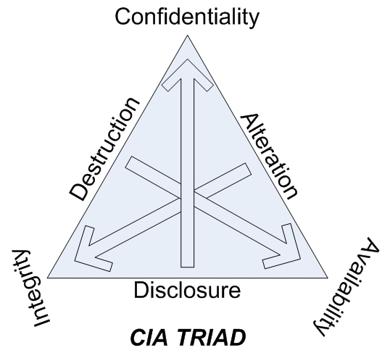
CIA Triad
Notes:
CIA Triad, Note as we move away from Disclosure we move towards confidentiality, etc. Reference: CISSP Study Guide by Conrad, Misenar, Feldman.

Slide 9
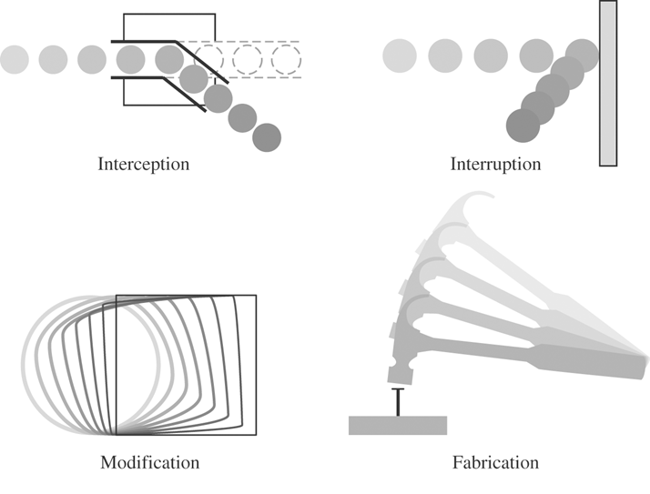
Threats
Interception: gained access to an asset.
Wireless network, hacked system, etc.
Impacts confidentiality.
Interruption
Unavailability, reduced availability.
Modification
Tamper with data, impacts integrity.
Fabrication
Spurious transactions, impacts integrity.
Notes:
Interception, interruption, Modification, Fabrication

Slide 10
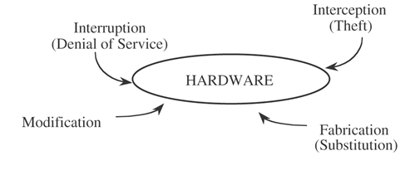
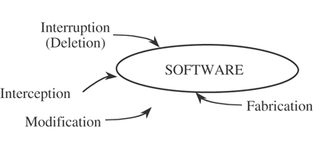
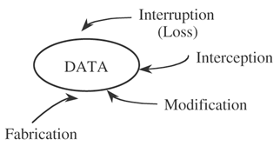
Figure - Vulnerabilities of Computing Systems.

Slide 11
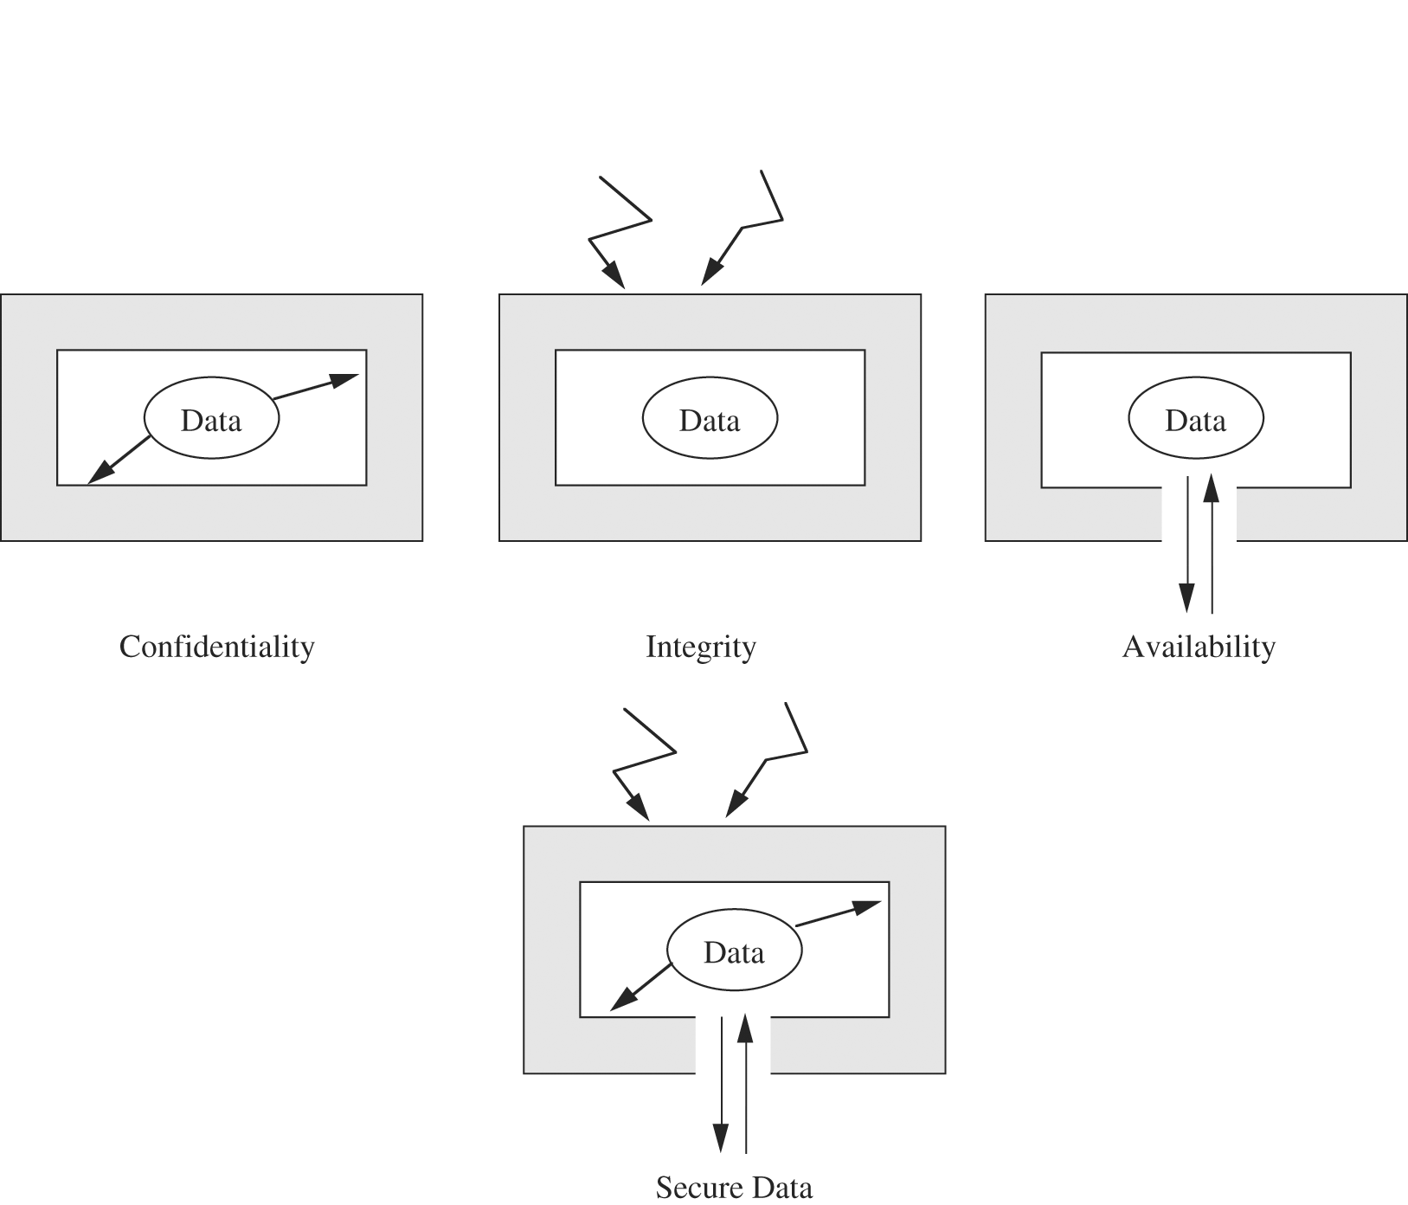
Figure - Security of Data.
Notes:
Confidentiality protect access, Integrity: protect change, Availability keep accessible

Slide 12
Attacker Needs
What are 3 things must an attacker have?
Notes:
Method (skill), opportunity, motive

Slide 13
An Attacker Must Have:
Method: skills, knowledge, tools.
Capability to conduct an attack
Opportunity: time and access to accomplish attack
Motive: a reason to want to attack

Slide 14
Software Vulnerabilities
Define some different types.
There are many to chose from….
Notes:
bomb, trojans, virus, trapdoor, information leak, worm

Slide 15
Software Vulnerabilities
Logic Bomb: employee modification.
Trojan Horse: Overtly does one thing and another covertly.
Virus: malware which requires a carrier
Trapdoor: secret entry points.
Information Leak: makes information accessible to unauthorized people.
Worm: malware that self-propagates.

Slide 16
Criminals
Define different types of computer criminals and their motive or motives?
Notes:
Script kiddies, crackers, professional criminals, hacktivists, terrorist, phishers, insiders

Slide 17
Computer Criminals
Script Kiddies: Amateurs
Crackers/Malicious Hackers: Black Hats
Career Criminals: botnets, bank thefts.
Terrorists: local and remote.
Hacktivists: politically motivated
Insiders: employees
Phishers/Spear Phishers
Notes:
70% of attacks internal? Still relevant?

Slide 18
Motives
Financial gain: make money.
Competitive advantage: steal information.
Curiosity: test skills.
Political: achieve a political goal.
Cause Harm/damage: reputation or financial
Vendetta/Disgruntled: fired employees.

Slide 19
Risk
What are the different ways a company can deal with risk?
Notes:
CISSP ways to deal with risk, accept, mitigate, transfer, avoid. Book: prevent it, deter it, deflect it, detect it, recover

Slide 20
How to deal with Risk
Accept it: cheaper to leave it unprotected.
Mitigate it: lowering the risk to an acceptable level e.g. (laptop encryption).
Transfer it: insurance model.
Avoid it: sometimes it is better not to do something that creates a great risk.
Notes:
CISSP ways to deal with risk. Book: prevent it by fixing vulnerability, deter it making it harder, deflect it by making other targets more attractive, detect it as it happens, recover from its effects.
Reference: Conrad, E., Misenar, S., Feldman, J. (2010) CISSP Study Guide

Slide 21
Risk mitigation
Prevent it by fixing vulnerability,
Deter it making it harder,
Deflect it by making other targets more attractive,
Detect it as it happens,
Recover from its effects
Reference: Conrad, E., Misenar, S., Feldman, J. (2010) CISSP Study Guide

Slide 22
Possible Controls
Encryption: confidentiality, integrity
VPN, SSH, Hashes, data at rest, laptops.
Software: operating system, development.
Hardware: Firewall, locks, IDS, 2-factor.
Policies and Procedures: password changes
Physical: gates, guards, site planning.
Notes:
Encrypt data at rest and communication channels. Policies must be easy to follow and understandable.

Slide 23
Types of Controls
Preventive: prevent actions.
Detective: notice & alert.
Corrective: correcting a damaged system.
Recovery: restore functionality after incident.
Deterrent: deter users from performing actions.
Compensating: compensate for weakness in another control.
Notes:
Reference: Conrad, E., Misenar, S., Feldman, J. (2010) CISSP Study Guide

Slide 24
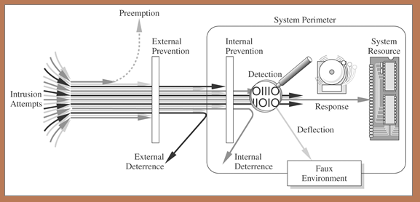
Figure - Multiple Controls.
Notes:
Defense in Depth. Is it still valuable? Attackers now leverage email, social engineering, viruses to get inside access.

Slide 25
Principles
Easiest Penetration: attackers use any means available to attack.
Adequate Protection: protect computers/data until they lose their value.
Effectiveness: controls must be used properly to be effective. Efficiency key.
Weakest Link: only as strong as weakest link - People
Notes:
4 principles mentioned in chapter 1.

Slide 26
CIA summary
Confidentiality: authorized access
Integrity : accurate unmodified consistent data
Availability: get when needed.
Security implies ‘trust’.

